Slide 1
Potato Disease Classification
Faysal Miah ID: 1721758042

Slide 2
Problem Statement
Farmers who grows potatoes are facing lot of economic losses every year because of various diseases that can happen to a potato plant. There are two common diseases known as early blight and late blight. If farmer can detect these diseases early and apply appropriate treatment then it can save lot of waste. The goal of this project to accurately identify those disease so that farmers can take step.
Dataset - https://www.kaggle.com/datasets/arjuntejaswi/plant-village
Data preprocessing
Model Building
Evaluation

Slide 3
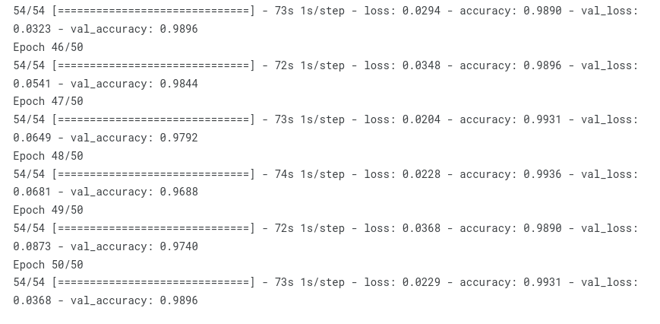
Result

Slide 4
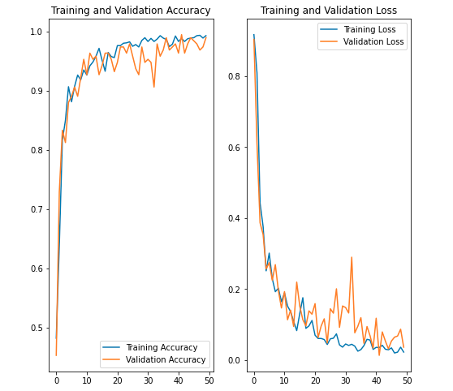
Result

Slide 5
